Slide 1

PUSL2026 - Computer Networks
Lecture 1 - Introduction to Computer Networks
Chamara Disanayake
Senior Lecturer
Department of Network and Security

Slide 2
Module Overview
PUSL2026 – Computer Networks
10 Lectures
2 Practical sessions
Tutorials and Case studies
Exam 50% Assignment 50%
Assignments :
Quizzes – MCQ – 20% ( Can be In-class Tests)
Group Assignment – 30%

Slide 3
Module Objectives
To provide an overview of Local and Wide Area Network technologies and protocols and relate them to conceptual models.
To develop knowledge and skills relevant to the design implementation and configuration of network infrastructure.
To develop an awareness of current industry tools and standards used in computer network implementations and administrations.
To aware the students on the requirements and best practices in securing computer networks and network services.

Slide 4
Session Plan
Session Date and Time | Session Topic | Remarks
Lecture 1 | Introduction to computer networks | Lecture
Lecture 2/3 | Network Media and Hardware | Lecture/Practical
Lecture 4 | Layered Architecture of Network | Lecture
Lecture 5 | Network Requirements | Lecture
Lecture 6 | Network Designing and Implementation | Lecture
Lecture 7 | Network Addressing L2/L3 | Lecture
Lecture 8 | Routing and switching | Lecture
Lecture 9 | Network Management and Security | Lecture
Lecture 10 | Revision

Slide 5

Why We Learn Computer Networks?
Computers are just stand-alone digital devices
Calculator + Organizer + Word Processor + Multimedia Player
If No Networking,
You can’t do E-learning, E-Marketing, Entertainments, Communication
No social media, No information sharing via computer devices
You will just spend less that 5% of the time you are now spend with network enabled IT devices

Slide 6
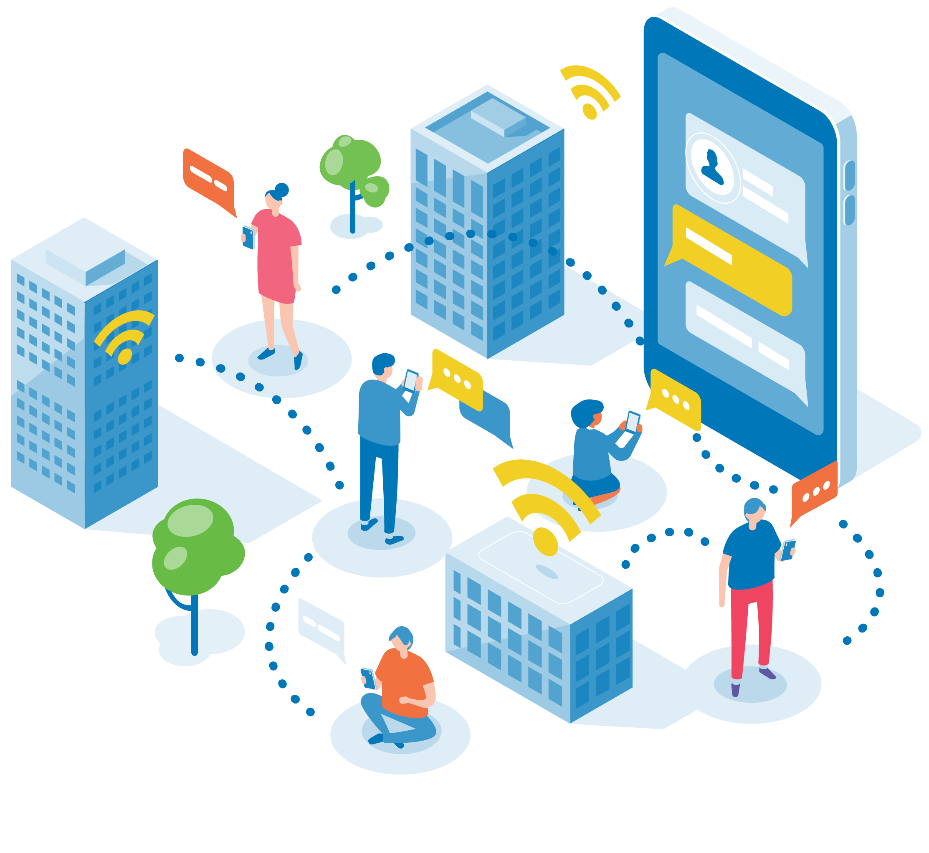
What Networking Enables
Sharing Information and Resources
Media, News sites, File storages, Computational resources, IT services (Cloud Delivery Models)
Digitalized Services
E-banking, E-learning, E-Health, E-business
Entertainments and social networking

Slide 7
What are the Barriers
Technology and Financial constrains
Technology change and technology awareness (Human resources) can be an issue
Cost and affordability as well as micro and macro environmental facts
Security and Privacy
Networking encourage security threats and attacks
Main Objective of the Department of Network and Security (DNS)
is to develop the skills of the Networking Graduates to cater the demand in the networking and security industry while improving the understanding of IT graduates on basics of Networking

Slide 8


Value of Networks and Security
Career Opportunities in ICT
Network Administrator
Network Engineer
Network Architect
Cloud Network Engineer
Security Administrator
Security Engineer
Security Manager/ Security Specialist

Slide 9
Topics Cover in the Module
Requirement of Networks
Technologies related to networks
Devices / Connection Media
Design and Implementation of networks
Requirements and Objectives
Implementation Techniques
IP Addressing and Routing
Network Management
Network Security
New techniques in networking
Virtualization, cloud and future trends on networking

Slide 10


Communication
Main feature/requirement of all living being
No matter how primitive they are.
It is a Requirement

Slide 11
Communication – Technological Era
Requirements
High speed – Must align with dynamic behavior of the world
Accuracy – No errors in the communication
Privacy – Only available to authorized parties
Authenticity – Validate sender / recipient, Non-repudiation
Resources and Features
High speed electronic devices
No human involvement in transferring data between the source and the destination
Both are IT devices including intermediate nodes

Slide 12
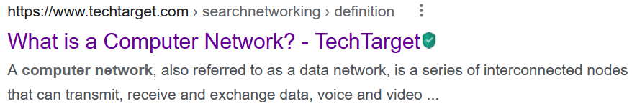
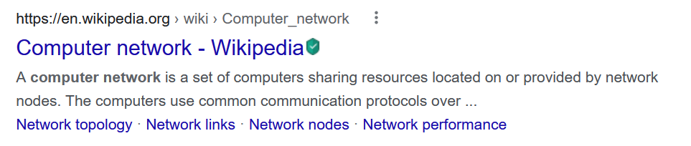
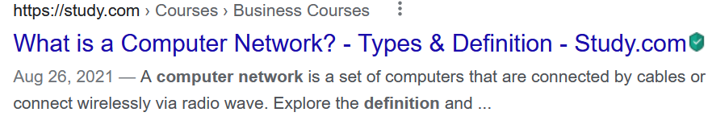
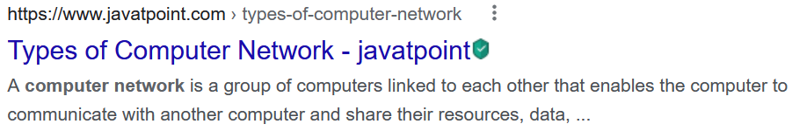
Computer Network?
As most of the electronic devices are capable of processing data/storing data (in binary form) based on the instruction given by a software [they are “Computers”]
They need to share information/data between the devices – Computer Network
Connecting two computers?
Connecting two or more devices to communicate ?

Slide 13
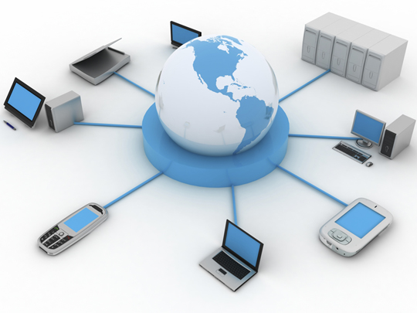
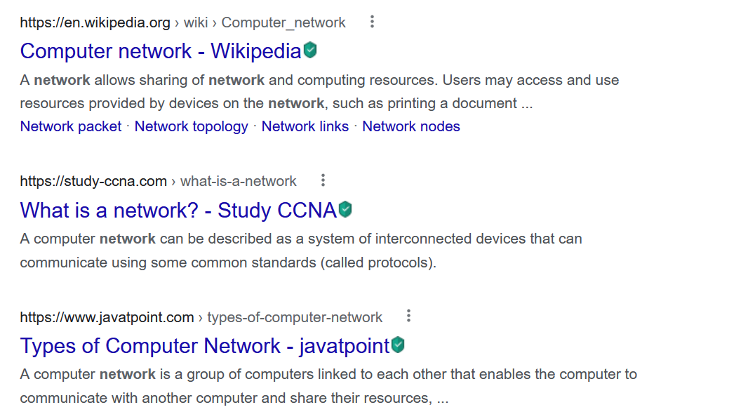
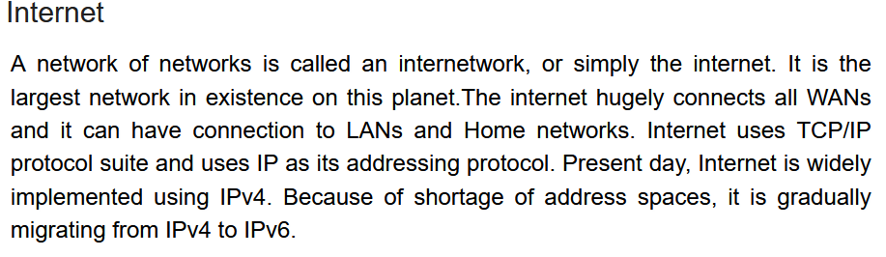
Computer Network is …
A system consists of two or more interconnected computers that are linked in order to share resources, exchange files, or allow electronic communications.
The computers on a network may be linked through cables, telephone lines, radio waves, satellites, or infrared light beams.

Slide 14
Requirements for an Effective Network
Two or more people or things with a common goal
A medium to communicate
A standard method or a common platform to exchange messages( Protocol)

Slide 15
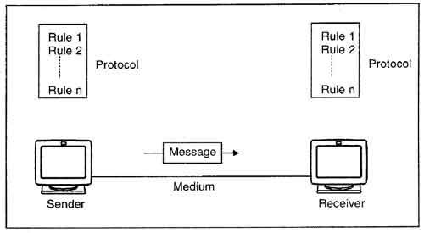
Where Data Communication Fits?
Data communication refers to the exchange of data between a source and a receiver via form of transmission media such as a wire cable.
Main Components of Data Communication
Message, Sender and Receiver
Communication Media
Protocol

Slide 16
What We are Going to Learn/Discuss
Network and Its Use
Why we need it? The requirements
How it needs to be done to fulfill the requirements? How to analysis the requirements
What are the Technologies to be used – Networking technologies
How the Network communication process, IP addresses and Routing – Logical layer
How to Securing the Network – Hardware and Software solutions
How to Managing and governing the Network

Slide 17
Basic Stuff

Slide 18
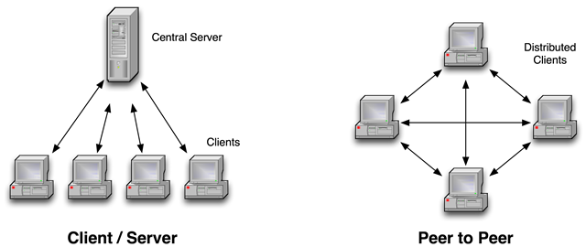
Network Types
One to One direct networks.(Peer to Peer )
One to Many Network (Client Server )

Slide 19
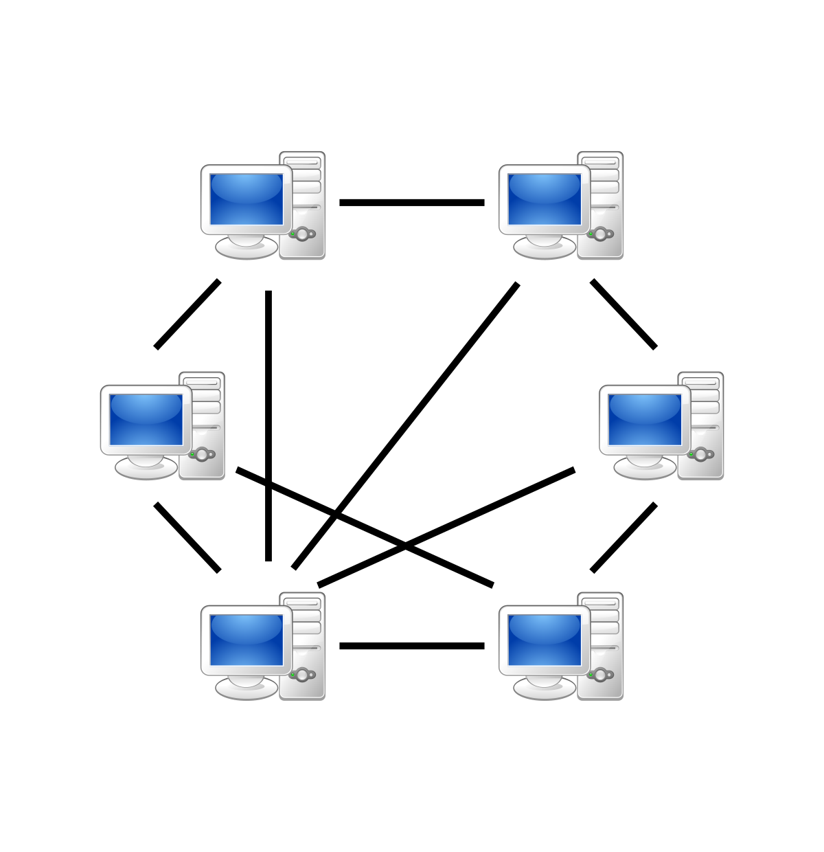
Peer to Peer
No centralized HW or control – decentralized
Self Organizing
No complex configurations and easy to implement.
Low-cost compared to opponent
Easy to manage and Maintain since minimal HW is required
Scalability is high but having issues in controllability and management

Slide 20
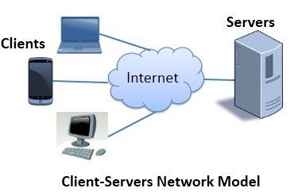
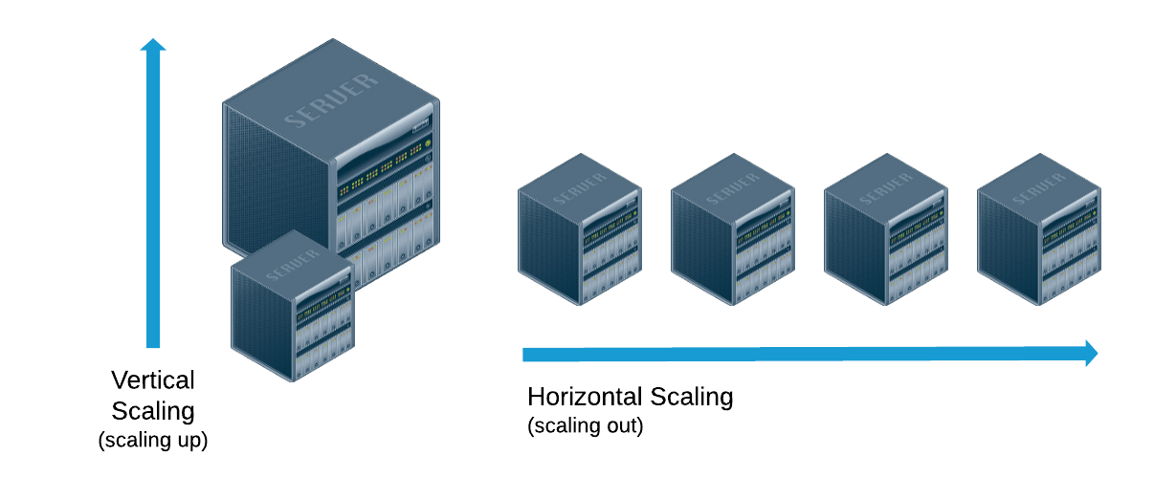
Central /Server Based Networks
1
Centralized control of resources
Failure in central point results in unusable network
Utilize faster processors, memory at central points based on capacity
Extra peripherals are required.
Controllability is higher than P2P
Scalability (Controlled)

Slide 21
Key components of a network
Network enabled device.
Interfacing HW
OS capable of interconnecting device.
Protocol or Standard set of instructions understandable by both sender and receiver and the connecting HW.
A medium which enable the hosts to communicate.

Slide 22
Basic Transmission Medium Concepts
Medium is the physical path between transmitter and receiver in a data transmission system
Guided Medium: waves are guided along a solid medium path (twisted pair, coaxial cable, and optical fiber).
Unguided medium: waves are propagated through the atmosphere and inner/outerspace (satellite, laser, and wireless transmissions).

Slide 23
Medium : Examples by type
Conductive: twisted pairs and coaxial cables
Light: lasers and optical fibers (need clear line of sight)
Electromagnetic: microwave, ISM band Inner/outer space - satellite (omnidirectional → security issues)

Slide 24
How You Measure the Bandwidth of a cable?
Number of bits passing through a point over a time.
100bps → 100 bits passed through a point within one second
100Mbps → 100x10^6 bits per second
What is the data rate?
Data rate is measured in ‘Bytes’
Byte = bits/8
i.e 1 Byte = 8 bits
If a network has a bandwidth of 100 Mbps (100,000,000 bps), the data rate is 12.5 MBps (100,000,000 bps / 8).
Here is a formula for calculating data rate from bandwidth:
Data rate = Bandwidth / 8

Slide 25
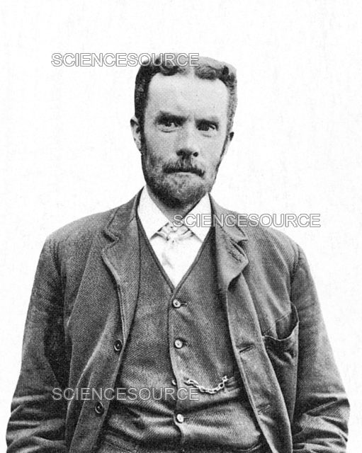

Coaxial Cables
Coaxial Cables were used for transmitting signals since 1850s.
The theory was described by an English Mathematician Oliver Heaviside
Consists of inter copper insulator covered by cladding material, and then covered by an outer jacket
← Inner conductor is solid copper metal
← Separated by insulating material
← Outer conductor is braided shielded (ground)
← Covered by sheath material

Slide 26
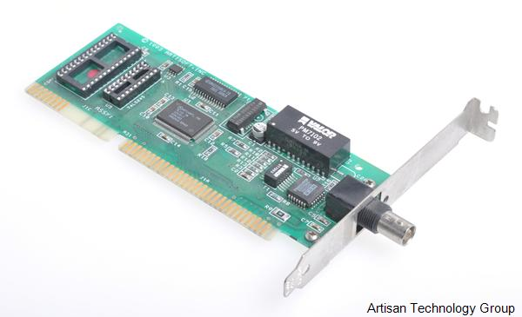
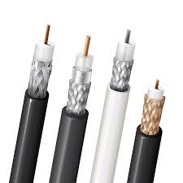
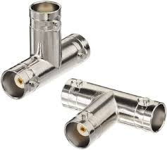
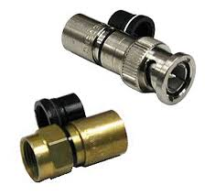
Coaxial cable
Coaxial cables are designed to carry high-frequency signals, such as those used in television, radio transmissions, internet, and other data transmission applications.
Widely installed for use in cable TVs and Sound transmissions.
Can transmit signals over 500m with low attenuation. Can transmit over longer distances with repeaters
Used different types of cables and connectors to connect devices to the network.

Slide 27
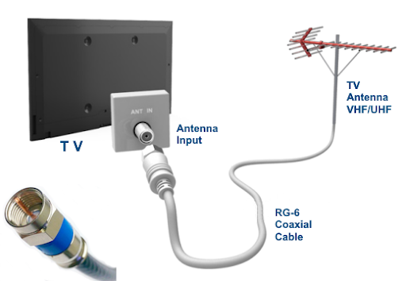
Coaxial cable …
Applications:
TV distribution (cable tv)
Long distance telephone transmission
Local Area Networks
Limitations:
Bulky and heavy
Half Duplex
Low efficient for complex networks

Slide 28
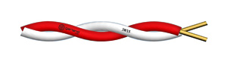
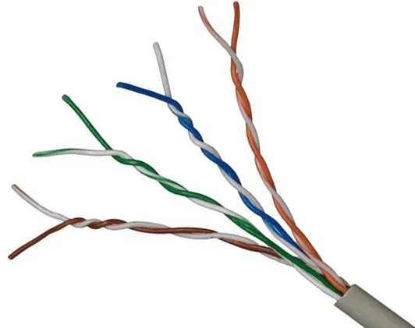
Twisted Pair Cables
Physical description:
Each wire with copper conductor, Separately insulated wires
Twisted together to reduce cross talk
Often bundled into cables of two or four twisted pairs
If enclosed in a sheath then is shielded twisted pair (STP) otherwise often for home usage unshielded twisted pair (UTP). Must be shield from voltage lines

Slide 29
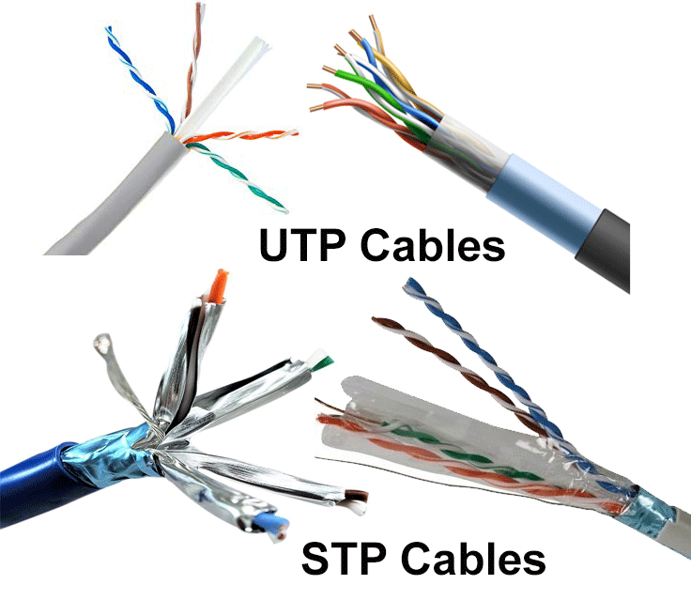
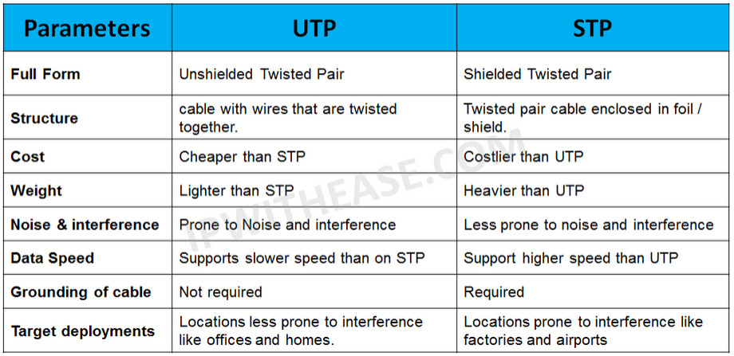
Twisted Pair Cables Types
Mainly Unshielded Twisted Pair (UTP) and Shielded Twisted Pair (STP) cables

Slide 30
Applications
Ethernet is a standard for connecting computers to a local area network (LAN).
Twisted pair is the most economical LAN cable and is often used by older telephone networks, although many networks have twisted pair wiring somewhere within the network.
Common in building for digital signaling used at speed of 100’s Mb/s (CAT5) and 1000Mb/s (CAT5) over 100s meters.
Common for telephone interconnection at home and office buildings
Less expensive medium; limited in distance, bandwidth, and data rate.

Slide 31
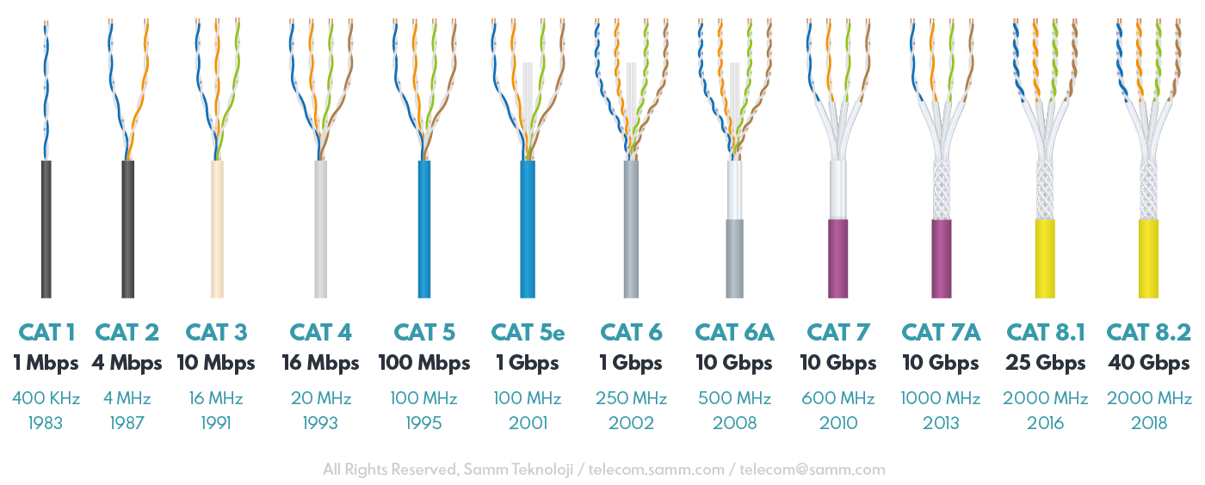
Categories of Twisted Pairs Cabling System
Category | Maximum data rate | Usual application
CAT 1 | Less than 1 Mbps | analog voice (plain old telephone service) Integrated Services Digital Network Basic Rate Interface in ISDN Doorbell wiring
CAT 2 | 4 Mbps | Mainly used in the IBM Cabling System for token ring networks
CAT 3 | 16 Mbps | Voice and data on 10BASE-T Ethernet (certify 16Mhz signal)
CAT 4 | 20 Mbps | Used in 16Mbps Token Ring Otherwise not used much
CAT 5 | 100 Mbps | 100 Mbps TPDDI 155 Mbps asynchronous transfer mode (certify 100 Mhz signal)
CAT 5e /6 | 1000Mbps | LAN,CCTV any Data communication applications
CAT 6a/7/8 | 10Gbps/40Gbps | Server rooms, LAN

Slide 32
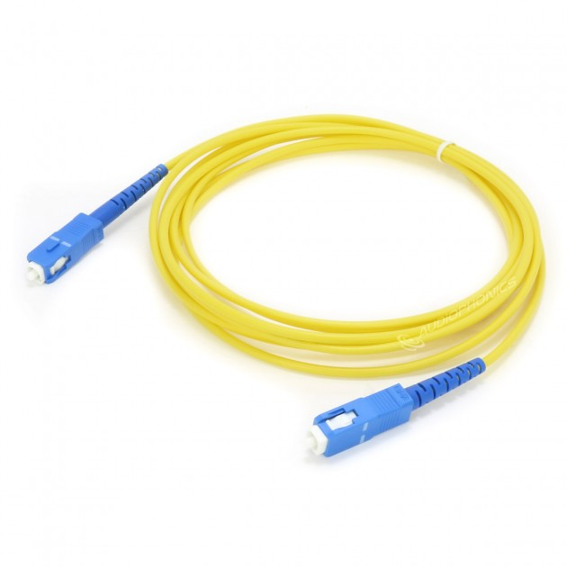
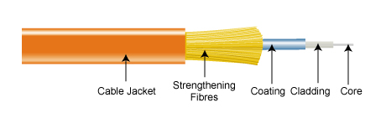
Optical Fibers
Physical Description:
Glass or plastic core of optical fiber = 2 to125 µm
Cladding is an insulating material
Jacket is a protective cover
Laser or light emitting diode provides transmission light source

Slide 33
Optical Fibers …
Applications:
Long distance telecommunication
Greater capacity; 2 Gb/s over 10’s of Km
Smaller size and lighter weight
Lower attenuation (reduction in strength of signal)
Electromagnetic isolation – not effected by external electromagnetic environment. Aka more privacy
Greater repeater spacing – fewer repeaters, reduces line regeneration cost

Slide 34
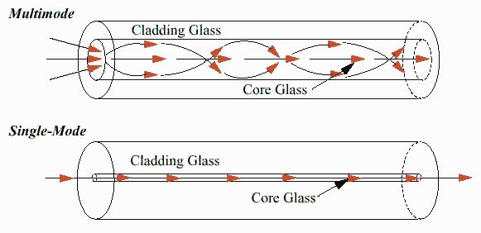
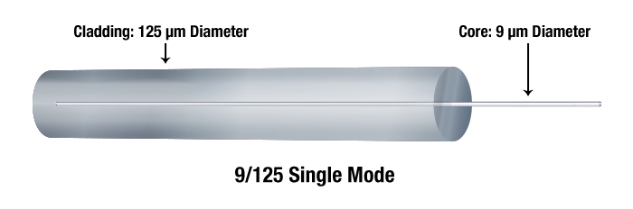
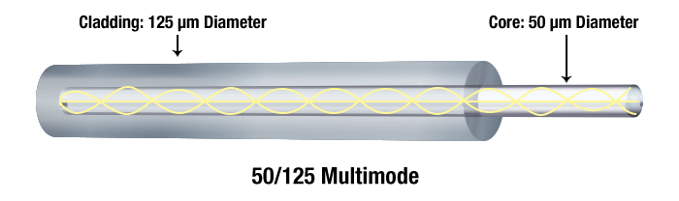
Optical Fibers ….
multimode fiber is optical fiber that is designed to carry multiple light rays or modes concurrently, each at a slightly different reflection angle within the optical fiber core
For longer distances, single mode fiber (sometimes called monomode) fiber is used. In single mode fiber a single ray or mode of light act as a carrier

Slide 35
Wireless Communication
Wireless communication plays a significant role in day-to-day life.
Wireless technology has become an integral part of our daily activities.
The transmission of data or information from one place to another wirelessly is referred to as wireless communication.
This provides an exchange of data without any conductor through RF and radio signals.
The term “wireless” refers to the communication or transmission of information over a distance without requiring wires, cables, or any other electrical conductors.
The information is transmitted across the devices over some meters to hundreds of kilometers through well-defined channels.
Some examples of wireless communication include cellular phones, GPS devices, TV/AC remotes, walkie-talkies, and car keys.

Slide 36
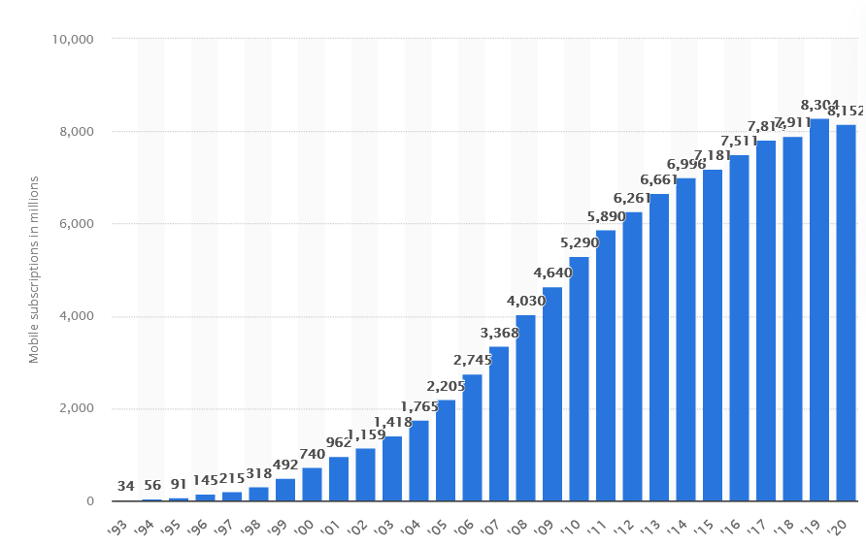
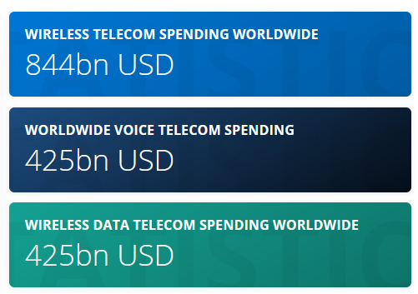
Wireless Communication – Current Status
With the increasing popularity of mobile devices, the demand for mobile communication technology continues to rapidly grow all around the world.
The global mobile data traffic, increase from 7 exabytes per month in 2016 to 49 exabytes per month by 2021.
As of June 2017, the number of mobile wireless subscriptions worldwide already was at around 7.7 billion, with the GSM, LTE, and HSPA technologies accounting for almost all of connections.

Slide 37
Why it is So Popular
Convenience
Ability to provide user mobility, meaning that unlike wired communication, the destination address doesn’t mean a fixed destination location.
Cost-effectiveness
Absence of the need for additional infrastructure for every new member of the network implies a lower installation cost per person.
Maintenance costs are also quite low as a majority of the components of the wireless systems are not physical entities that could fall victim to wear and tear.
Speed
Advent of 4G technology and Voice-over-LTE, have enabled higher rates of data transfer to a wider audience, without sacrificing the connectivity strength.

Slide 38
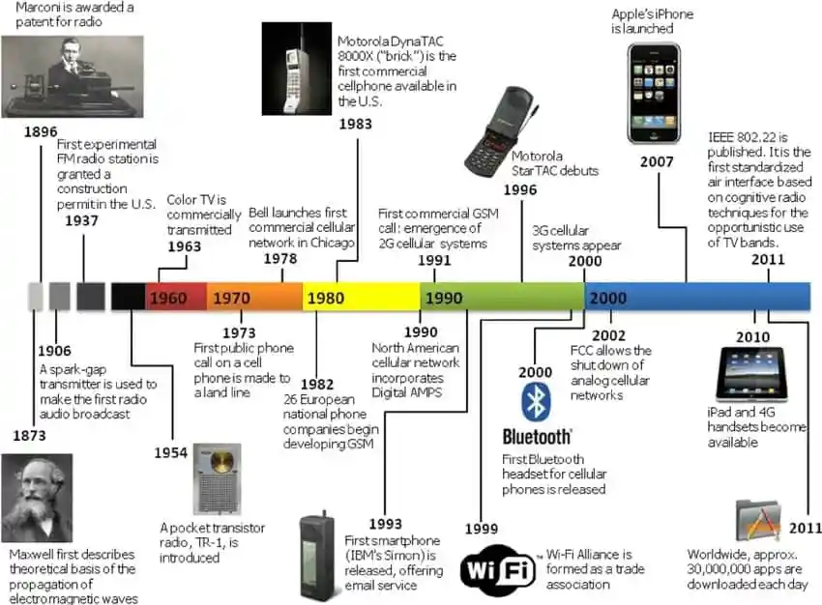
History of Wireless Communication
In 1873, Maxwell proposed the idea of using electromagnetic waves to propagate the transmission of message signals, which is the underlying concept behind wireless communication.
Guglielmo Marconi invented the first wireless device, the wireless Telegraph, in 1896 and was awarded the patent for his radio the same year. The very next year, the first wireless message was sent, which read “Are you ready?”, across a distance of 6km.

Slide 39
Evolution …
After 1990…
In the 1990s, GSM came into the picture, connecting many more people, and brought about the second generation of mobile telephony(2G).
Wireless Fidelity(WiFi) came into existence in the late 1990s.
Soon after, in the year 2000, Bluetooth was invented along with the release of the third-generation (3G) of mobile telephony. These two technologies revolutionized the way people shared messages, bringing more into the wireless world.
In 2007, Apple released its first iPhone (the first “actual smartphone”), which lead to an exponential increase in the number of smartphones in the market.
In 2010, the fourth generation(4G) of mobile telephony rolled out, which provide facilities such as Voice over LTE.
Now we have 5G in 2020

Slide 40
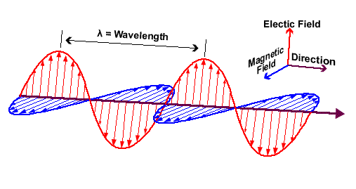
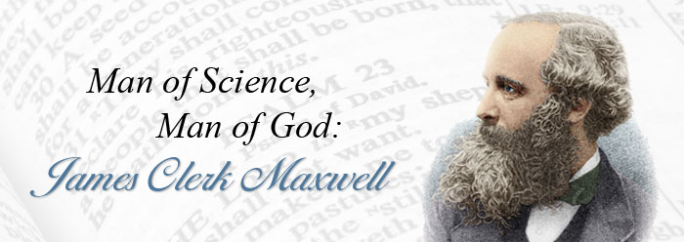
The Electromagnetic Waves
EM waves form the foundation of the information age and the technologies we use every day: radio, television, consumer electronics, remote controls, cell phones, microwave ovens, X-rays and other medical technologies all use EM waves.
These electromagnetic (EM) waves are ubiquitous, and without them life as we know it would not exist.
EM waves transmit energy, but unlike water or sound waves, they do not need a medium to travel through. They move through the vacuum of space at the speed of light (about 300,000 km/s = 3x10⁸MS⁻¹).
Light is also an EM Wave – light is a propagating wave of electric and magnetic field 1864 Maxwell.
Electromagnetic energy travels in waves that span a broad spectrum.

Slide 41
The Electromagnetic Spectrum
Electromagnetic energy travels in waves that span a broad spectrum.
These electromagnetic (EM) waves are ubiquitous, and without them life as we know it would not exits.
EM waves form the foundation of the information age and the technologies we use every day: radio, television, consumer electronics, remote controls, cell phones, microwave ovens, X-rays and other medical technologies all use EM waves.
EM waves transmit energy, but unlike water or sound waves, they do not need a medium to travel through. They move through the vacuum of space at the speed of light (about 300,000 km/s).

Slide 42
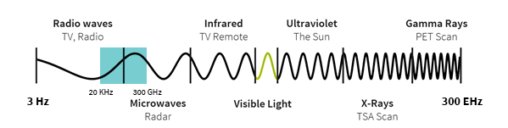
The Spectrum
Spectrum consists of a range of Electromagnetic Frequencies

Slide 43
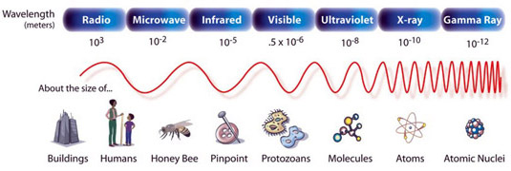
Wave length with the Spectrum

Slide 44
Types of Wireless Data Transmission
Radio Frequency Transmission
Microwave Transmission
Infrared Transmission
Lightwave Transmission

Slide 45
Radio Frequency Transmission
Radiofrequency is a form of electromagnetic transmission used in wireless communication.
RF signals are easily generated, ranging 3kHz to 300GHz.
These are used in wireless communication because of their property to penetrate through objects and travel long distances.
Radio communication depends on the wavelength, transmitter power, receiver quality, type, size, and height of the antenna.

Slide 46
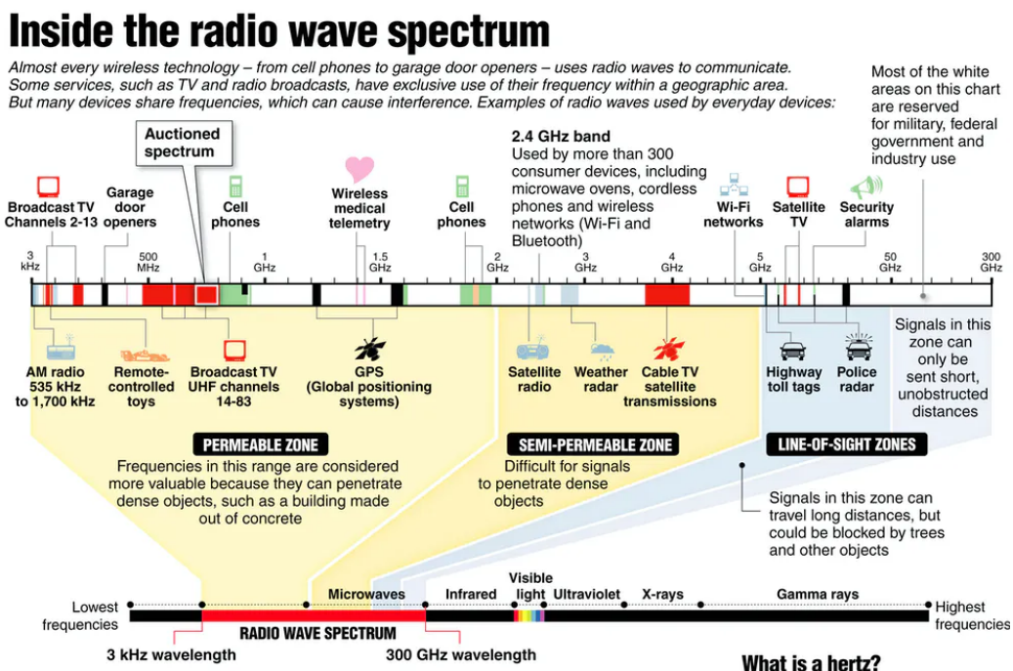

Slide 47
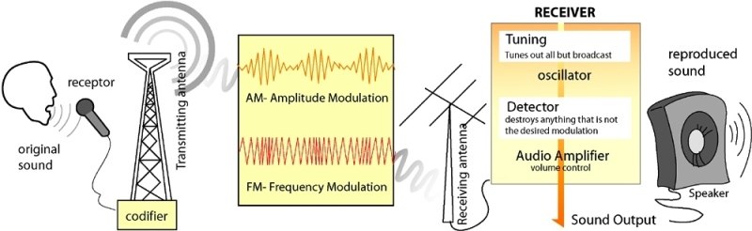
Broadcast Radio
The first wireless communication technology is open radio communication to seek out widespread use, and it still serves a purpose nowadays.
Multichannel radios permit a user to speak over short distances, whereas citizen’s band and maritime radios offer communication services for sailors.

Slide 48
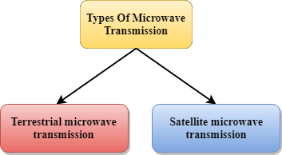
Microwave Transmission
The wavelength of microwaves ranges from one meter to one millimeter.
The frequency varies from 300MHz to 300GHz. These are widely used for long-distance communications and are relatively less expensive.
Microwave is an effective type of wireless data transmission that transfers information using two separate methods.
Satellite transmission - SMTS
Terrestrial transmission - TMTS

Slide 49
Satellite Microwave Transmission System (SMTS)
Satellite communication is one type of self-contained wireless communication technology, it is widely spread all over the world to allow users to stay connected almost anywhere on the earth.
When the signal (a beam of modulated microwave) is sent near the satellite then, the satellite amplifies the signal and sent it back to the antenna receiver which is located on the surface of the earth.
Receives transmissions on one frequency band (uplink), amplifies or repeats the signal, and transmits it on another frequency (downlink)

Slide 50
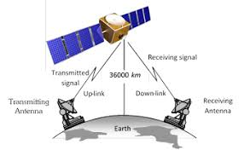
Satellite Communication
Satellite communication contains two main components like the space segment and the ground segment.
The ground segment consists of fixed or mobile transmission, reception, and ancillary equipment and the space segment, satellite that orbits 22,300 miles above the Earth.
Applications
Television distribution
Long-distance telephone transmission
Private business networks

Slide 51
Characteristics of Satellite Technology
Very little capability to repair a Satellite.
greater delay .
attenuation Issue.
Use for one directional communication ( Satellite TV/Radio).
Connect highly remote locations ( when there is no other means)
Emergency and Secure communications for military /rescue work.

Slide 52
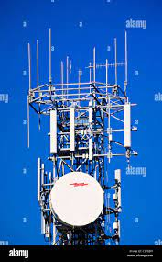
Terrestrial Microwave Transmission Systems (TMTS)
Terrestrial microwave is a wireless microwave networking technology that uses line-of sight communications between pairs of Earth-based transmitters and receivers to relay information.
The signals are extremely concentrated and the physical route must be line of sight.
The signals in these systems are extended with the help of Relay towers.
Terrestrial Microwave Systems need directional parabolic antennas to broadcast and receive signals in the lower gigahertz range.
The frequency of data transmission for terrestrial systems is typically 4 GHz to 6 GHz or 21 GHz to 23 GHz, and the speed is usually 1 megabit per second (Mbps) to 10 Mbps.

Slide 53
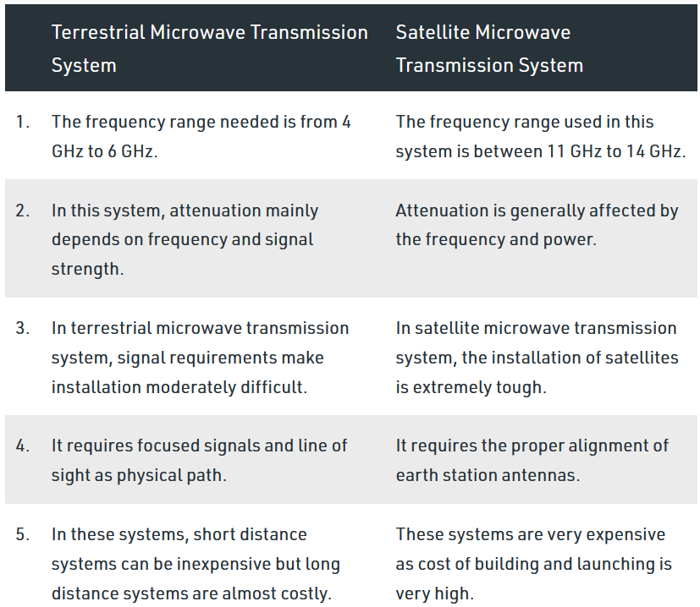
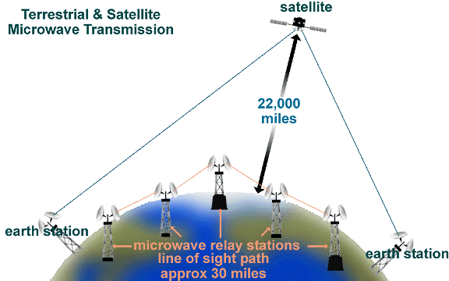
Comparison
Comparison

Slide 54
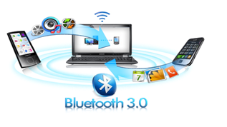
Bluetooth
Bluetooth technology is a high-speed low powered wireless technology link that is designed to connect phones or other portable equipment together.
It follows specification (IEEE 802.15.1)
The main function of Bluetooth technology is that permits you to connect various electronic devices wirelessly to a system for the transferring of data.
Cell phones are connected to hands-free earphones
PCs/Laptops :mouse, wireless keyboard.
Data transfer
This technology has various functions and it is used commonly in the wireless communication market.

Slide 55
Mobile Communication Systems
The advancement of mobile networks is enumerated by generations.
Many users communicate across a single frequency band through mobile phones.
Cellular and cordless phones are two examples of devices that make use of wireless signals.
Typically, cell phones have a larger range of networks to provide coverage. But, Cordless phones have a limited range. Similar to GPS devices, some phones make use of signals from satellites to communicate.

Slide 56
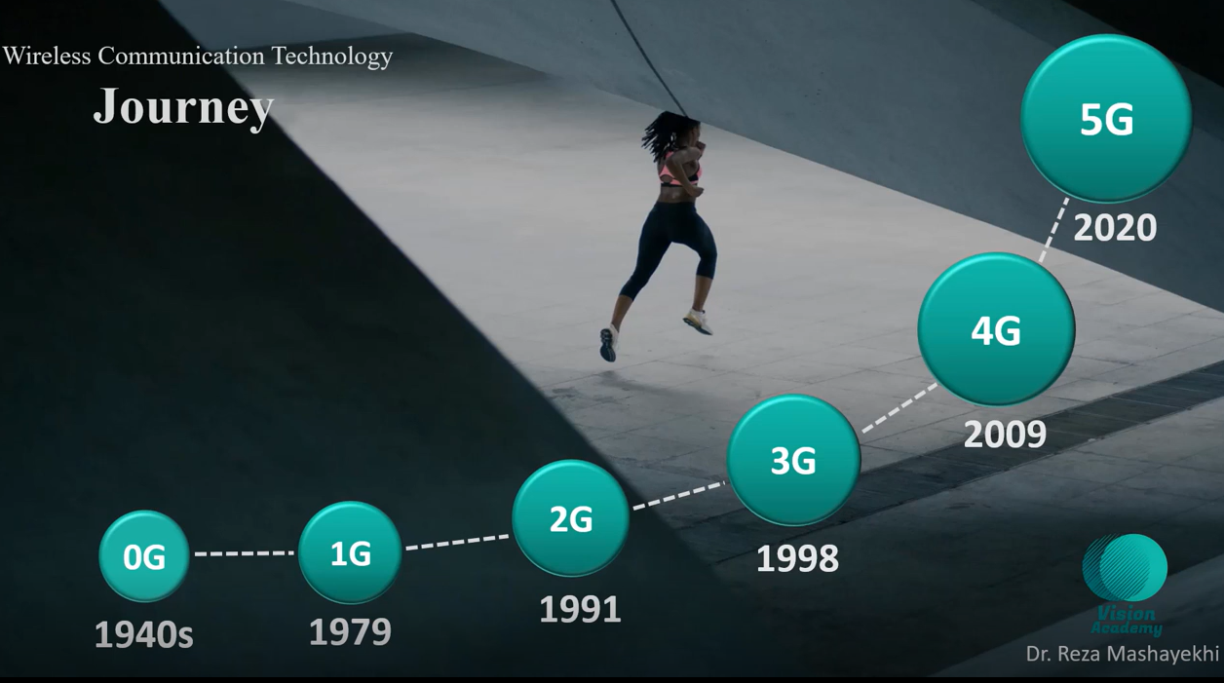
Evolution of Mobile Communication Technology
0 G
1G
2G
3G
4G
5G

Slide 57
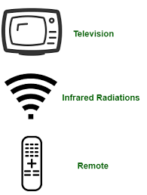
Infrared (IR) Transmission
Infrared radiations are electromagnetic radiations with longer wavelengths than visible light.
These are usually used for short-range communications. These signals do not pass through solid objects.
Two Types
Point-to-point system in which transmission is possible between two points limited to a range and line of sight.
100 GHz to 1,000 terahertz (THz), and the speed ranges from 100 Kbps to 16 Mbps.
It is used for security control, TV remote control, and short-range communications

Slide 58
IR Communication
For successful infrared communication, a photo LED transmitter and a photodiode receptor are required.
The LED transmitter transmits the IR signal in the form of nonvisible light, that is captured and saved by the photoreceptor.
The LED on being biased emits light of the wavelength of 940nm as a series of pulses, corresponding to the button pressed.
The transmitted signal is modulated using a carrier frequency of 38 KHz (or any other frequency between 36 to 46 KHz).
So the information between the source and the target is transferred in this way.
The source and destination can be mobile phones, TVs, security systems, laptops

Slide 59

Infrared
Type 2 - Diffuse Point
Another method of transmission of infrared includes the broadcast system – and, in this method, reflective material or a transmission unit amplifies and retransmits a data signal to several other units.
The normal frequency of an infrared broadcast system is 100 GHz to 1,000 THz with a limited speed of 1 Mbps.
Example: A sound wave can be transmitted over Infrared signals

Slide 60
Wireless Transmission
Frequency range (line of sight):
26 GHz to 40 GHz: for microwave with highly directional beam as possible
30 MHz to 10 GHz: for omnidirectional applications
300MHz to 20000 GHz: for infrared spectrum; used for point to point and multiple point application (line of sight)
Physical applications:
Terrestrial microwave (alternative to coaxial or optical fiber).
IP microwave (low latency communication)
Few amplifier and repeaters
Propagation via towers located without blockage from trees, etc (towers less than 60 miles preffered but some locations may carry far than ).

Slide 61
Wireless Transmission….
Satellite is a microwave relay station
Geostationary orbit (22,000 miles) and low orbit (12000 miles)
Satellite ground stations are aligned to the space satellite, establishes a link, broadcast at a specified frequency. Ground station normally operate at a number of frequencies – full duplex
Satellite space antenna is aligned to the ground station establishes a link and transmits at the specified frequency. Satellite are capable of transmitting at multiple frequencies simultaneously, full duplex.
To avoid satellites from interfering with each other, a 4 degree separation is required for 4/6 GHz band and 3 degree for 12/14 GHz band. Limited to 90 satellites.

Slide 62
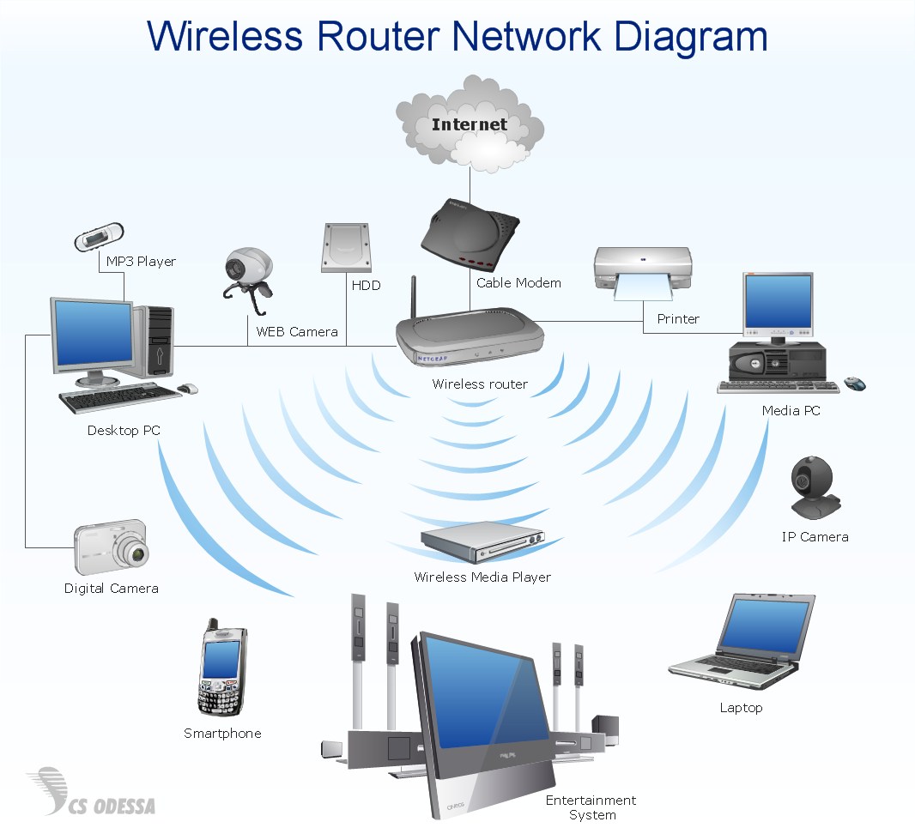
Wireless LAN - IEEE 802.11 (wifi)
Wireless LAN – WLAN
Wireless LAN, is a network of computers over distances of a few hundred feet that uses high frequency radio signals (2.4GHz/ 5 GHz) to transmit and receive data.

Slide 63
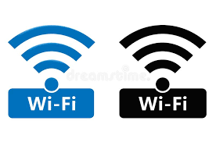
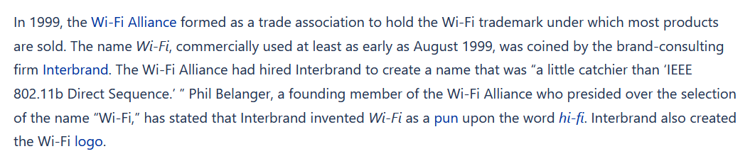

Wi-Fi vs WLAN
WI-FI means Wireless Fidelity
The first version of the 802.11 protocol was released in 1997, and provided up to 2 Mbit/s link speeds. This was updated in 1999 with 802.11b to permit 11 Mbit/s link speeds, and this proved to be popular.
An association of companies all around the globe called “The WI-FI Alliance” endorses WLAN technology and the products involved with it.
This alliance also certifies various hardware and devices if they measure up to the standards of interoperability. It should be mentioned that there are numerous devices that indeed conform to the standards but are not certified by the WI-FI Alliance and therefore, do not sport the WI-FI logo. The reason for this is the cost and hassle of the certification procedure.

Slide 64
Discussion Time
Any questions ?

